Slide 1
Introduction To IBM Universal Database For Linux, UNIX And Windows
4. Database Security

Slide 2
Agenda
Database Security
  Authentication
  Authorities
  Privileges

Slide 3
DB2 Security Mechanisms
There are three main mechanisms within DB2 that allow a DBA to implement a database security plan:
  Authentication
    DB2 authentication works closely with the security features of the underlying operating system to verify user IDs and passwords
  Authorization
    Authorization involves determining the operations that users and/or groups can perform, and the data objects that they may access
  Privileges
    Privileges help define the objects that a user can create or drop. They also define the commands that a user can use to access objects

Slide 4
DB2 Authentication

Slide 5

DB2 Authentication Vs. Authorization
Authorization:
Does Linda have an authorization to perform SELECT on myTable?
myTable
DB2 uses a combination of:
  External security service
  Internal access control information
Authentication
  Identify the user
    Check entered username and password
  Done by security facility outside DB2 (Part of the OS, DCE, Kerberos …)
Authorization
  Check if authenticated user may perform requested operation
  Done by DB2 facilities
    Information stored in DB2 catalog, DBM configuration file
db2 "select * from mytable"
Authentication:
Is pwd the correct password for linda?
db2 connect to mydb user linda using pwd

Slide 6
DB2 Authentication
DB2 authentication controls the following aspects of a database security plan:
  Who is allowed access to the instance and/or database
  Where and how a user's password will be verified
It does this with the help of the underlying operating system security features whenever an attach or connect command is issued
  An attach command is used to connect to the DB2 instance
  A connect command is used to connect to a database within a DB2 instance

Slide 7
DB2 Authentication Types
Authentication types are used by DB2 to determine where authentication is to take place
The following table summarizes the available DB2 authentication types
Types | Description
SERVER | Authentication takes place on the server
SERVER_ENCRYPT | Authentication takes place on the server. Passwords are encrypted on the client before being sent to the server
CLIENT | Authentication takes place on the client machine
KERBEROS | Authentication is performed by the Kerberos security software
KRB_SERVER_ENCRYPT | Authentication is performed by Kerberos security software if the client setting KERBEROS. Otherwise, SERVER_ENCRYPT is used
Default for SAP

Slide 8
Setting Authentication On The Server
Authentication is set on the database server within the Database Manager Configuration (DBM CFG) file using the AUTHENTICATION parameter
Example:
  To view the authentication parameter in the configuration file
  db2 get dbm cfg
  To alter the authentication parameter to SERVER_ENCRYPT:
  db2 update dbm cfg using authentication SERVER_ENCRYPT
  db2stop
  db2start

Slide 9
Setting Authentication On The Client
The client authentication setting must match that of the database server to which the client is connecting
  (with the exception of KRB_SERVER_ENCRYPT)
Client authentication is set using the catalog database command
Example:
  Let's assume the server authentication type is set to SERVER. The following command would then be issued to catalog the server database named sample:
  db2 catalog database sample at node nd1 authentication server
  If the authentication type is not specified, the client will try to use SERVER_ENCRYPT by default

Slide 10
Dealing With Untrusted Clients
If the server or gateway machine has authentication set to CLIENT, this implies that the client is expected to authenticate a user's ID and password
However, some client machines may not have operating systems with native security features
  Such untrusted clients include DB2 clients running on Windows 98
There are two additional parameters in the DBM CFG file used to determine where authentication should take place when the server or gateway authentication method is set to CLIENT and untrusted clients are attempting to connect to the database or attach to the DB2 instance
  TRUST_ALLCLNTS
  TRUST_CLNTAUTH

Slide 11
Dealing With Untrusted Clients (Cont’d)
TRUST_ALLCLNTS
  Decide whether to trust all clients
    YES: All clients, whether or not they are trusted, are forced to authenticate at the client
    NO: All untrusted clients will be authenticated at the server (meaning that a user ID and password must be provided) – all trusted clients will be authenticated at the client machine
    DRDAONLY: Trust only clients that are running on iSeries or zSeries platforms (i.e., DRDA clients) – any other clients must provide user ID and password

Slide 12
Dealing With Untrusted Clients (Cont’d)
TRUST_CLNTAUTH
  Where will the authentication take place when a user ID and password are supplied and authentication type is CLIENT
    CLIENT: Authentication is done at the client; a user ID and password are not required
    SERVER: Authentication is done at the server if a user ID and password are supplied
    If no user ID and password are supplied, the authentication will take place at the client

Slide 13
Database Authentication – Example
UPDATE DBM CFG USING AUTHENTICATION SERVER_ENCRYPT
  db2 connect to sample
    Only possible on database server
    All clients will be authenticated at the Server – no connect possible without supplying user ID and password from a client machine
    Connection data is send encrypted from the client to the server
UPDATE DBM CFG USING AUTHENTICATION CLIENT THRUST_ALLCLNTS NO
  db2 connect to sample user john using pass
    Authentication on trusted Client
    All untrusted clients will be authenticated at the Server

Slide 14
Database Authentication – Example
UPDATE DBM CFG USING AUTHENTICATION CLIENT THRUST_ALLCLNTS NO TRUST_CLNTAUTH CLIENT
  db2 connect to sample user john using pass
    Authentication on Client
  db2 connect to sample
    Authentication on Client
UPDATE DBM CFG USING AUTHENTICATION CLIENT THRUST_ALLCLNTS NO TRUST_CLNTAUTH SERVER
  db2 connect to sample user john using pass
    Authentication on Server
  db2 connect to sample
    Authentication on Client

Slide 15
Database Authentication – Windows
DB2 for Windows exploits the native Windows security system to authenticate users
DB2 uses Windows to attempt to authenticate a user in the following order of user information:
  Local Security Access Manager (SAM)
  Domain Controller
  Trusted Domain Controller
  Example:
  If the authentication type is SERVER, the DB2 server attempts to authenticate the user at the server machine
  If the user is not defined in the server machine’s SAM, the authentication will be attempted on the domain controller
  If the user is not defined on the domain controller, the domain controller of the trusted domains is used
  If the user is not defined in the trusted domain, the authentication will fail

Slide 16
Authentication In A SAP Environment
Database
Server
disp+work.exe
Connect to SID user SAP<SID> using PASSWORD
Encrypt-/Decrypt
OS-API
User:
Algorithm
<SID>ADM
DSCDB6.CONF
DSCDB6UP

Slide 17
Authentication In A SAP Environment (Cont’d)
In a SAP environment, the disp+work processes are connected to the database as user sapr3/ sap<sid>
  Some database operations are also performed by user <sid>adm
Because an interactive logon is not possible, an encrypted password file is used to allow users access to the database
The password file is called dscdb6.conf and is located in the global directory of the /usr/sap file system
  The db2<sid> user needs read access to the password file
The password file is created by using the dscdb6up tool
  Please remember: Once you change the password of sapr3/sap<sid> and/or <sid>adm on the operating system level you must also update the dscdb6.conf file

Slide 18
DB2 Authorities

Slide 19
DB2 Authorities – Overview
DB2 authorities control the following aspects of a database security plan:
  The authority level that a user is granted
  The commands that a user is allowed to run
  The data that a user is allowed to read and/or alter
  The database objects a user is allowed to create, alter, and/or drop

Slide 20
DB2 Authorities – Overview (Cont’d)
Authorities are made up of groups of privileges and higher-level database manager (instance-level) maintenance and utility operations
  SYSADM, SYSCTRL and SYSMAINT are instance-level authorities
    These authorities can only be assigned to an (operating system) group; you can do so through the DBM CFG file
  The DBADM and LOAD authorities are assigned to a user or group for a particular database
    This can be done explicitly using the GRANT command

Slide 21
DB2 Authorities
SYSADM
SYSCTRL
DBADM
Cannot
Can access data
access data
Authorities
SYSMAINT
LOAD
PRIVILEGES
Ownership (Control)
Individual
Implicit

Slide 22
Obtaining Database Authorities
Instance-level authorities
  The authorities SYSADM, SYSCTRL, and SYSMAINT are associated with groups and are specified at the instance level
    UPDATE DBM CFG USING SYSADM_GROUP <GROUP1>
    every user ID that is a member of group1 will have SYSADM authority on this instance
    UPDATE DBM CFG USING SYSCTRL_GROUP <GROUP2>
    UPDATE DBM CFG USING SYSMAINT_GROUP <GROUP3>

Slide 23
Obtaining Database Authorities (Cont’d)
DBADM Authority
  The creator of a database will automatically have DBADM authority for the new database; Other users may be granted the DBADM authority by a SYSADM user:
    GRANT DBADM ON DATABASE TO USER <USER1>
LOAD Authority
  Only users with either SYSADM or DBADM authority are permitted to grant or revoke LOAD authority to users or groups
    GRANT LOAD ON DATABASE TO USER <USER1>

Slide 24
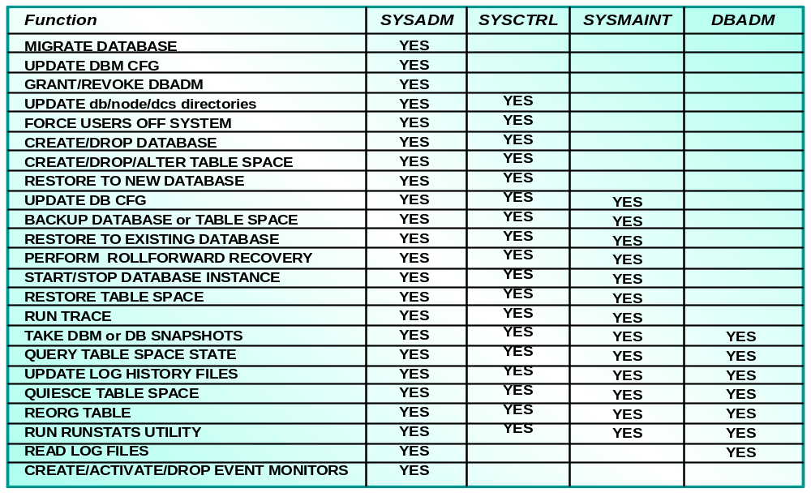
Database Authority Summary

Slide 25
Database Authority – Windows Considerations
In a Windows domain environment, a group list for the authenticated user is enumerated at the machine where the authentication is done
The DB2_GRP_LOOKUP registry variable allows to specify where the list of groups a user belongs to should be enumerated:
  LOCAL: At the DB2 server the list of groups is enumerated using the local SAM at the DB2 server
    By setting this value, the database administrator does not need to have the administrative authority for Windows domains
  DOMAIN: DB2 will always enumerate groups and validate user accounts on the user account’s Windows domain

Slide 26
DB2 Privileges

Slide 27
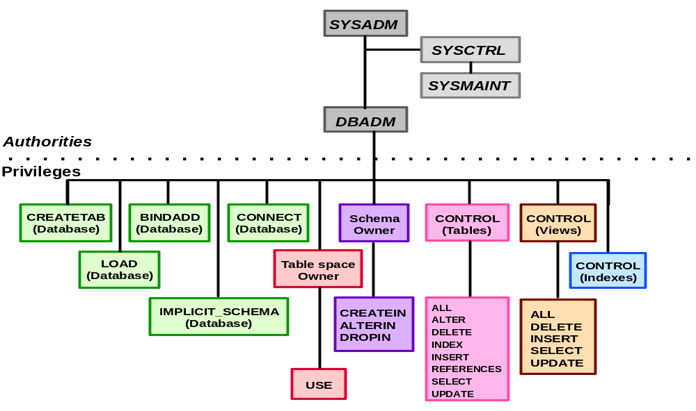
Authorities And Privileges

Slide 28
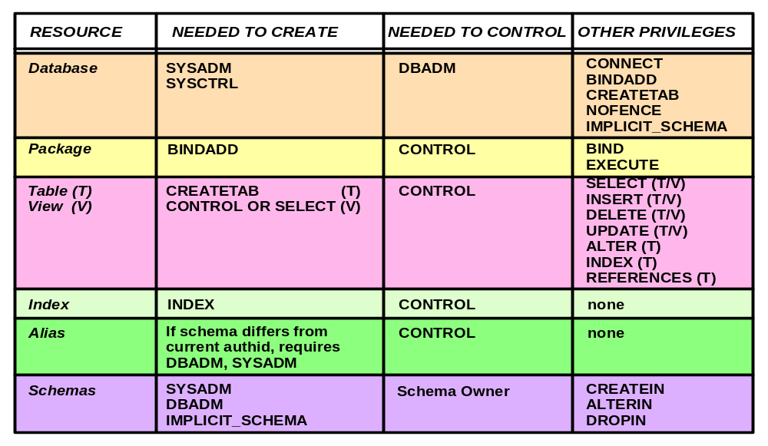
Resources: Privileges Required

Slide 29
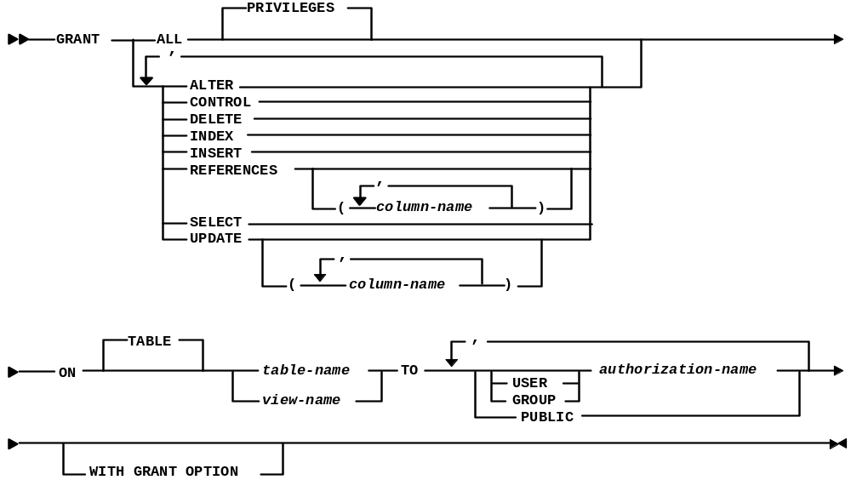
Grant Command – Table, View Privileges Support

Slide 30
Grant Explicit Privileges
Granting a privilege with grant option allows the authorization ID to extend the specified privilege to others
  This option is only available to package, routine, schema, table, table space, and view
Although the grant privilege is extended, the revoke privilege is not. If privileges are received through the with grant option, a user will not be able to revoke the privileges from others
Example
  This statement allows john to perform select, update, or delete operations on the table employee and to grant any of these privileges to others:
  db2 grant select, update, delete on table employee to user john with grant option

Slide 31
Example – Controlling Use Of Schemas
Schemas are named collection of objects
  Forms high-order part of objects with a two part name
User with DBADM authority creates schema PAY for user MEL
  CREATE SCHEMA PAY AUTHORIZATION MEL
Mel can create objects in schema pay
  CREATE TABLE PAY.T1 (COL1 INT)
Mel can grant privileges to other users:
  GRANT CREATEIN ON SCHEMA PAY TO USER CAL
  GRANT ALTERIN, CREATEIN, DROPIN ON SCHEMA PAY TO
  GROUP G1 WITH GRANT OPTION
Achieving greater schema control:
  REVOKE IMPLICIT_SCHEMA ON DATABASE FROM PUBLIC
  GRANT IMPLICIT_SCHEMA ON DATABASE TO USER JON

Slide 32
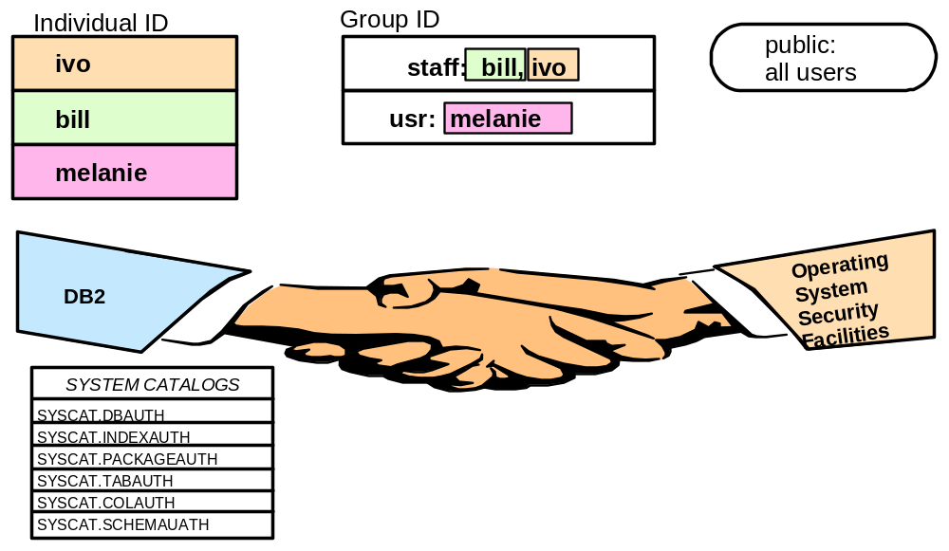
Individual IDs, Group IDs And Public
PUBLIC is a special DB2 group that includes all users of a particular database; PUBLIC does not have to be defined at the O/S level

Slide 33
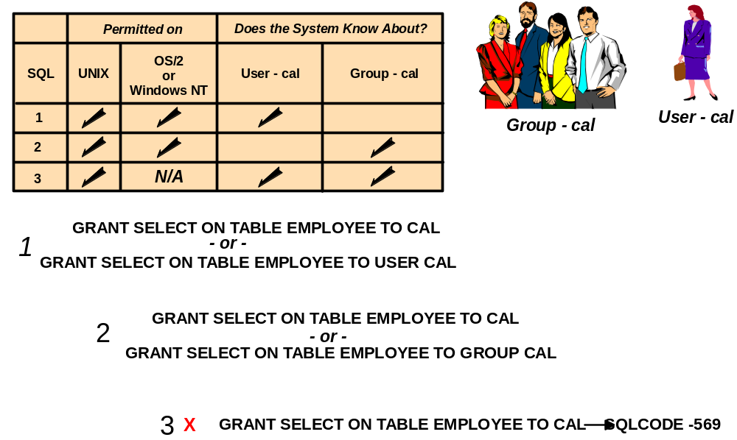
Group And User Support

Slide 34
Implicit Privileges
CREATE DATABASE
  Internal GRANT of DBADM authority with CONNECT, CREATETAB,
  BINDADD, CREATE_NOT_FENCED, LOAD and IMPLICIT_SCHEMA privileges to creator (SYSADM or SYSCTRL)
  Internal GRANT of BINDADD, CREATETAB, CONNECT and IMPLICIT_SCHEMA to PUBLIC
  BIND and EXECUTE privilege on each successfully bound utility to PUBLIC
  SELECT on system catalog tables and views to PUBLIC
  USE privilege on USERSPACE1 table space to PUBLIC
GRANT DBADM
  Internal GRANT of BINDADD, CREATETAB, CONNECT, CREATE_NOT_FENCED, LOAD and IMPLICIT_SCHEMA
Create object (table, index, package)
  Internal GRANT of CONTROL to object creator
Create view
  Internal GRANT to intersection of creator's privileges on base tables to view creator

Slide 35
Indirect Privileges
Privileges can be obtained indirectly when packages are executed by the database manager
  A package contains one or more SQL statements in an executable format
  If all the statements in the package are static, a user would only require EXECUTE privilege on the package to successfully execute the statements in the package
Example: Assume db2package1 executes the following static SQL statements:
db2 select * from org
db2 insert into test values (1, 2, 3)
  In this case, a user with EXECUTE privilege on db2package1 would indirectly be granted SELECT privilege on the table org and INSERT privilege on the table test

Slide 36
Query Privileges Granted To Current ID
db2 "SELECT * FROM SYSCAT.TABAUTH WHERE GRANTEE IN (USER, 'PUBLIC')"
db2 get authorizations
"Rounding up Privileges"

Slide 37
Grant/Revoke Scenarios 1/4
GRANT DBADM ON DATABASE TO USER SI1ADM
Get Authorizations
Administrative Authorizations for Current User
Direct SYSADM authority = NO
Direct SYSCTRL authority = NO
Direct SYSMAINT authority = NO
Direct DBADM authority = YES
Direct CREATETAB authority = YES
Direct BINDADD authority = YES
Direct CONNECT authority = YES
Direct CREATE_NOT_FENC authority = YES
Direct IMPLICIT_SCHEMA authority = YES
Direct LOAD authority = YES
Indirect SYSADM authority = NO
Indirect SYSCTRL authority = YES
Indirect SYSMAINT authority = NO
Indirect DBADM authority = NO
Indirect CREATETAB authority = NO
Indirect BINDADD authority = NO
Indirect CONNECT authority = NO
Indirect CREATE_NOT_FENC authority = NO
Indirect IMPLICIT_SCHEMA authority = YES
Indirect LOAD authority = NO

Slide 38
Grant/Revoke Scenarios 2/4
REVOKE DBADM ON DATABASE FROM USER SIDADM
Get Authorizations
Administrative Authorizations for Current User
Direct SYSADM authority = NO
Direct SYSCTRL authority = NO
Direct SYSMAINT authority = NO
Direct DBADM authority = NO
Direct CREATETAB authority = YES
Direct BINDADD authority = YES
Direct CONNECT authority = YES
Direct CREATE_NOT_FENC authority = YES
Direct IMPLICIT_SCHEMA authority = YES
Direct LOAD authority = YES
Indirect SYSADM authority = NO
Indirect SYSCTRL authority = YES
Indirect SYSMAINT authority = NO
Indirect DBADM authority = NO
Indirect CREATETAB authority = NO
Indirect BINDADD authority = NO
Indirect CONNECT authority = NO
Indirect CREATE_NOT_FENC authority = NO
Indirect IMPLICIT_SCHEMA authority = YES
Indirect LOAD authority = NO

Slide 39
Grant/Revoke Scenarios 3/4
REVOKE BINDADD ON DATABASE FROM USER SIDADM
Get Authorizations
Administrative Authorizations for Current User
Direct SYSADM authority = NO
Direct SYSCTRL authority = NO
Direct SYSMAINT authority = NO
Direct DBADM authority = NO
Direct CREATETAB authority = YES
Direct BINDADD authority = NO
Direct CONNECT authority = YES
Direct CREATE_NOT_FENC authority = YES
Direct IMPLICIT_SCHEMA authority = YES
Direct LOAD authority = YES
Indirect SYSADM authority = NO
Indirect SYSCTRL authority = YES
Indirect SYSMAINT authority = NO
Indirect DBADM authority = NO
Indirect CREATETAB authority = NO
Indirect BINDADD authority = NO
Indirect CONNECT authority = NO
Indirect CREATE_NOT_FENC authority = NO
Indirect IMPLICIT_SCHEMA authority = YES
Indirect LOAD authority = NO

Slide 40
Grant/Revoke Scenarios 4/4
GRANT DBADM ON DATABASE TO USER SI1ADM
Get Authorizations
Administrative Authorizations for Current User
Direct SYSADM authority = NO
Direct SYSCTRL authority = NO
Direct SYSMAINT authority = NO
Direct DBADM authority = YES
Direct CREATETAB authority = YES
Direct BINDADD authority = YES
Direct CONNECT authority = YES
Direct CREATE_NOT_FENC authority = YES
Direct IMPLICIT_SCHEMA authority = YES
Direct LOAD authority = YES
Indirect SYSADM authority = NO
Indirect SYSCTRL authority = YES
Indirect SYSMAINT authority = NO
Indirect DBADM authority = NO
Indirect CREATETAB authority = NO
Indirect BINDADD authority = NO
Indirect CONNECT authority = NO
Indirect CREATE_NOT_FENC authority = NO
Indirect IMPLICIT_SCHEMA authority = YES
Indirect LOAD authority = NO

Slide 41
Query Who Has Which Privileges
Most of the information on authorizations is maintained in seven system catalog tables:
  SYSCAT.DBAUTH Database privileges
  SYSCAT.COLAUTH Table and View Column privileges
  SYSCAT.INDEXAUTH Index privileges
  SYSCAT.PACKAGEAUTH Access Package privileges
  SYSCAT.SCHEMAAUTH Schema privileges
  SYSCAT.TABAUTH Table and view privileges
  SYSCAT.TBSPACEAUTH Table space privileges
  SYSADM, SYSCTRL and SYSMAINT authority and group membership are defined outside Database Manager and are therefore not reflected in system catalogs

